Slide 1
DS Task 1 SQL

Slide 2
Agenda
Objective of the Task
Understanding the Data
Approach and Steps Taken
Handling Special Requirements
Why Use PostgreSQL for This Project?
ERD Design

Slide 3
1.Objective of the Task
The goal of this task was to compile a comprehensive dataset of player statistics, including goals, assists, minutes played, and additional derived metrics, and link these statistics to their respective teams.

Slide 4
2.Understanding the Data
worked with five main tables:
Players: containing basic information about each player.
Teams: detailing each team.
PlayerStats: recording the statistical performance of players.
TransferHistory: documenting player transfers between teams.
Matches:Records details about each football match.

Slide 5
3.Approach and Steps Taken
Step 1: Identifying Required Data :
first identified the key metrics we needed: total goals, assists, average minutes played, and derived metrics like whether the player played over 300 minutes, their age range, and if they scored 3 or more goals in a match.

Slide 6
Step 2: Planning the Query:
planned query to join the necessary tables. By joining Players with Teams, linked each player to their current team. used a left join with PlayerStats to ensure that players with no stats were still included. Subqueries were used to gather transfer information for France and Italy.

Slide 7
Step 3:
Aggregating Data: aggregated the data using SQL functions such as SUM, AVG, and MAX. To handle any missing data, used the COALESCE function, which allowed to provide default values.

Slide 8
Step 4: Creating Conditional Columns:
To create binary indicators for specific conditions, used CASE statements. For example, to check if a player played more than 300 minutes, or if their age was between 25 and 30 years.

Slide 9
Step 5: Formatting the Output :
also formatted the estimated matches played by dividing the total minutes by 90 and then concatenating the results into a readable format.

Slide 10
4.Handling Special Requirements:
needed to determine if players had played in France or Italy. This was done using EXISTS clauses to check for any matching transfer records, and subqueries to find the earliest transfer dates to these countries.

Slide 11
6.Why Use PostgreSQL for This Project?
Advanced SQL Features: Supports complex queries, window functions, and CTEs.
Data Integrity and ACID Compliance: Ensures reliable transactions and maintains data integrity.
Robust Query Support: Efficiently handles multiple joins, subqueries, and aggregations.
Extensibility: Allows custom functions, data types, and operators.
Open Source and Community Support: Continuous improvements, extensive documentation, and support.
Performance and Scalability: Manages large datasets and high-transaction workloads.
Security Features: Advanced security with row-level security, SSL, and robust authentication.

Slide 12
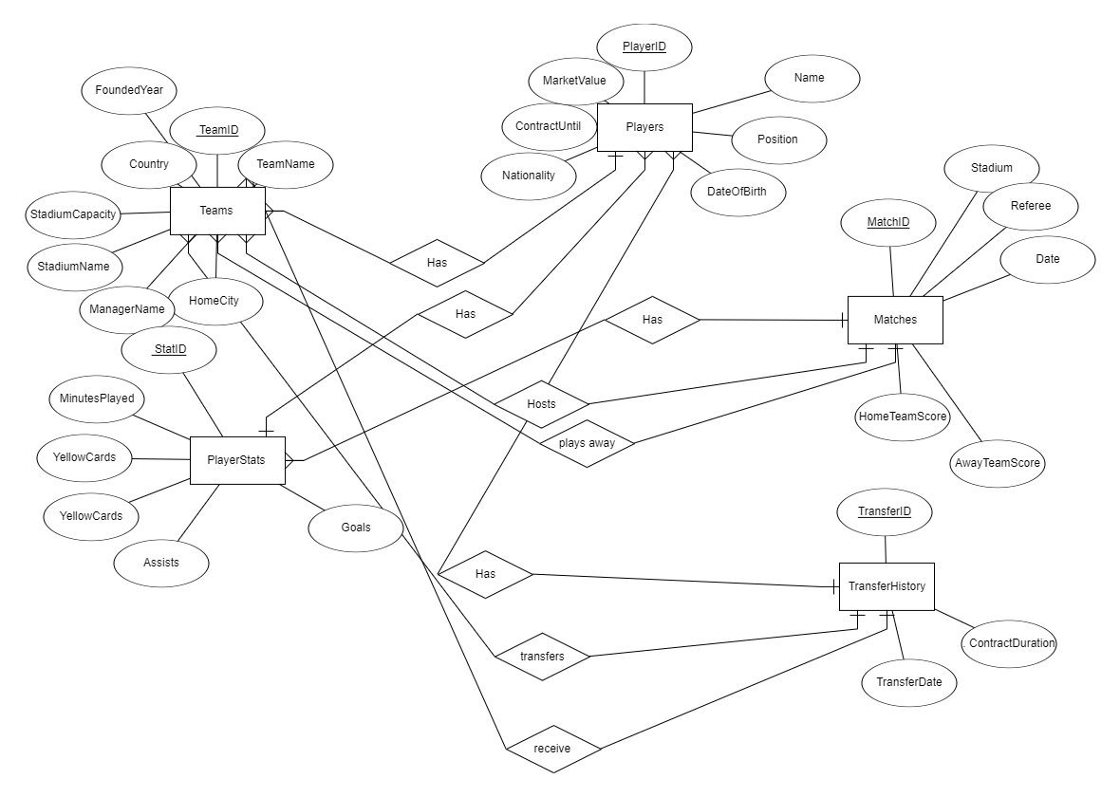
7.ERD Design

Slide 13
Prepared by :Yasmin Gamal
Supervised by : Eng/Omar ,Eng/ Sherif

